Slide 1
ITP 449
Cici Han

Slide 2
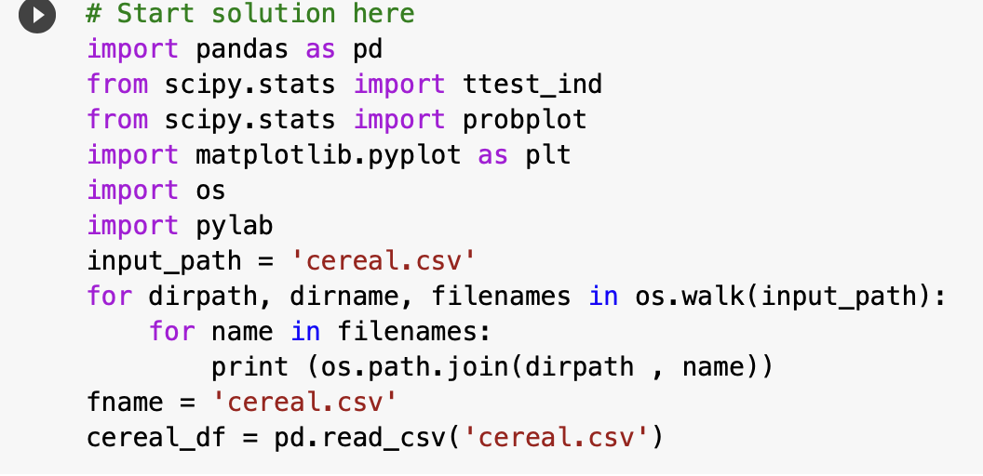
Read Data

Slide 3
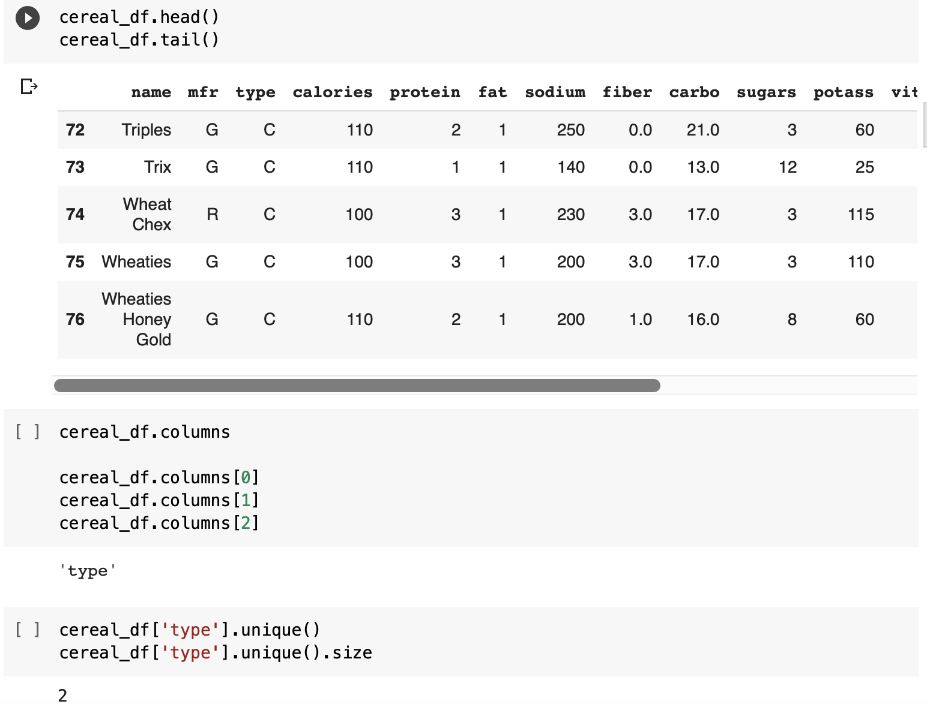
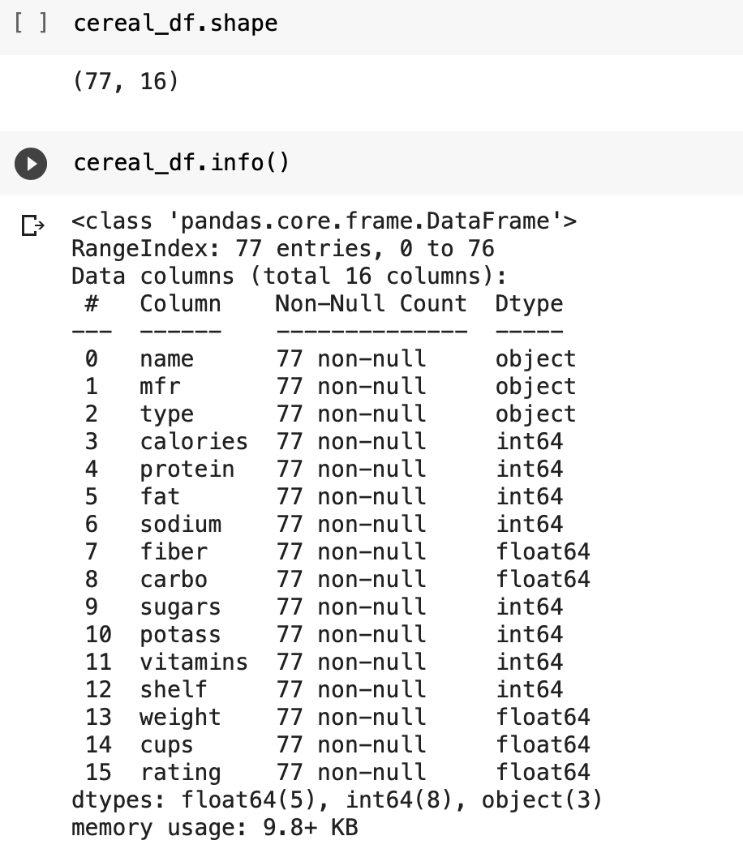
Explore Data

Slide 4
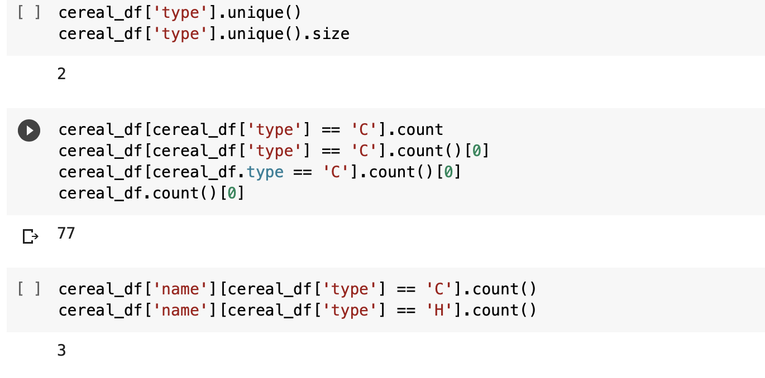
Summarizing Data 1 Categories: Type

Slide 5
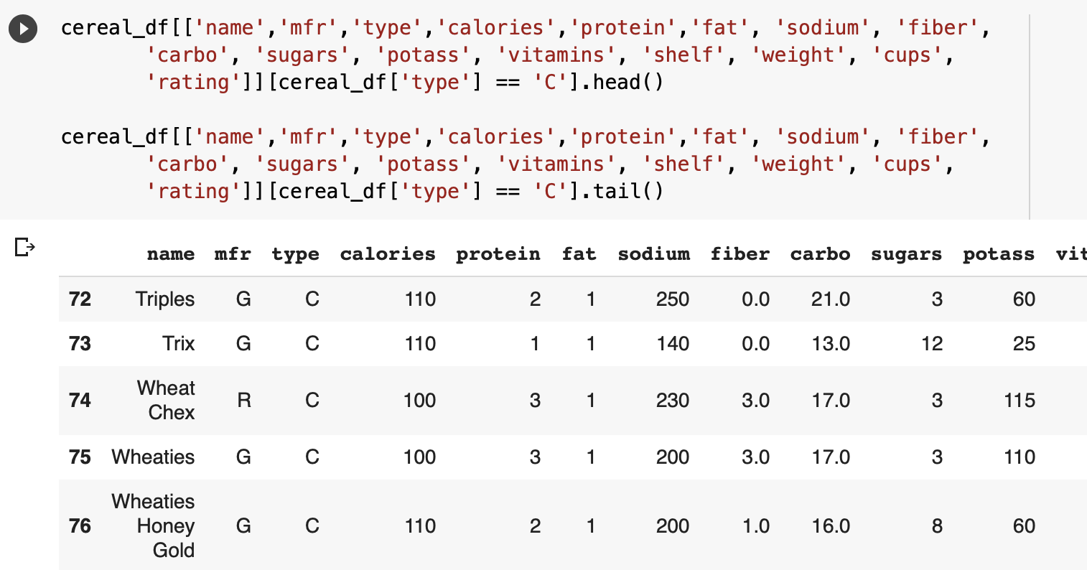
Summarizing Data 1 Categories: Type

Slide 6
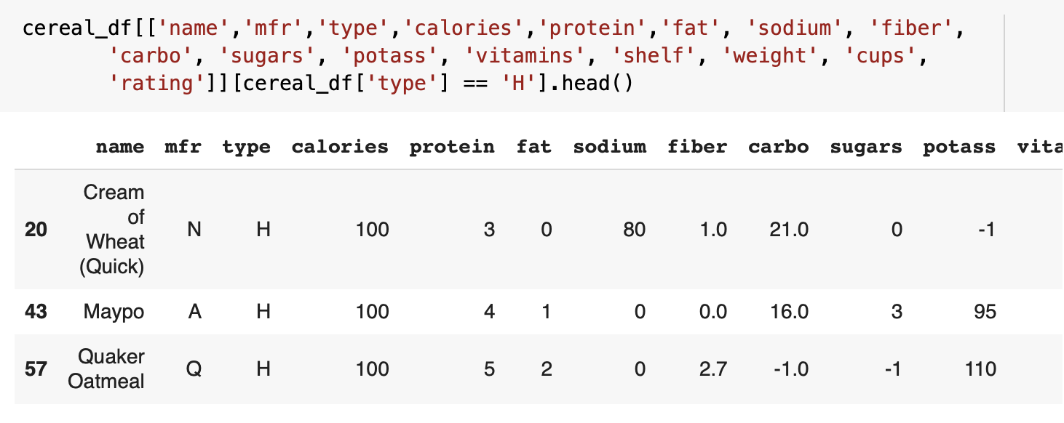
Summarizing Data 1 Categories: Type

Slide 7
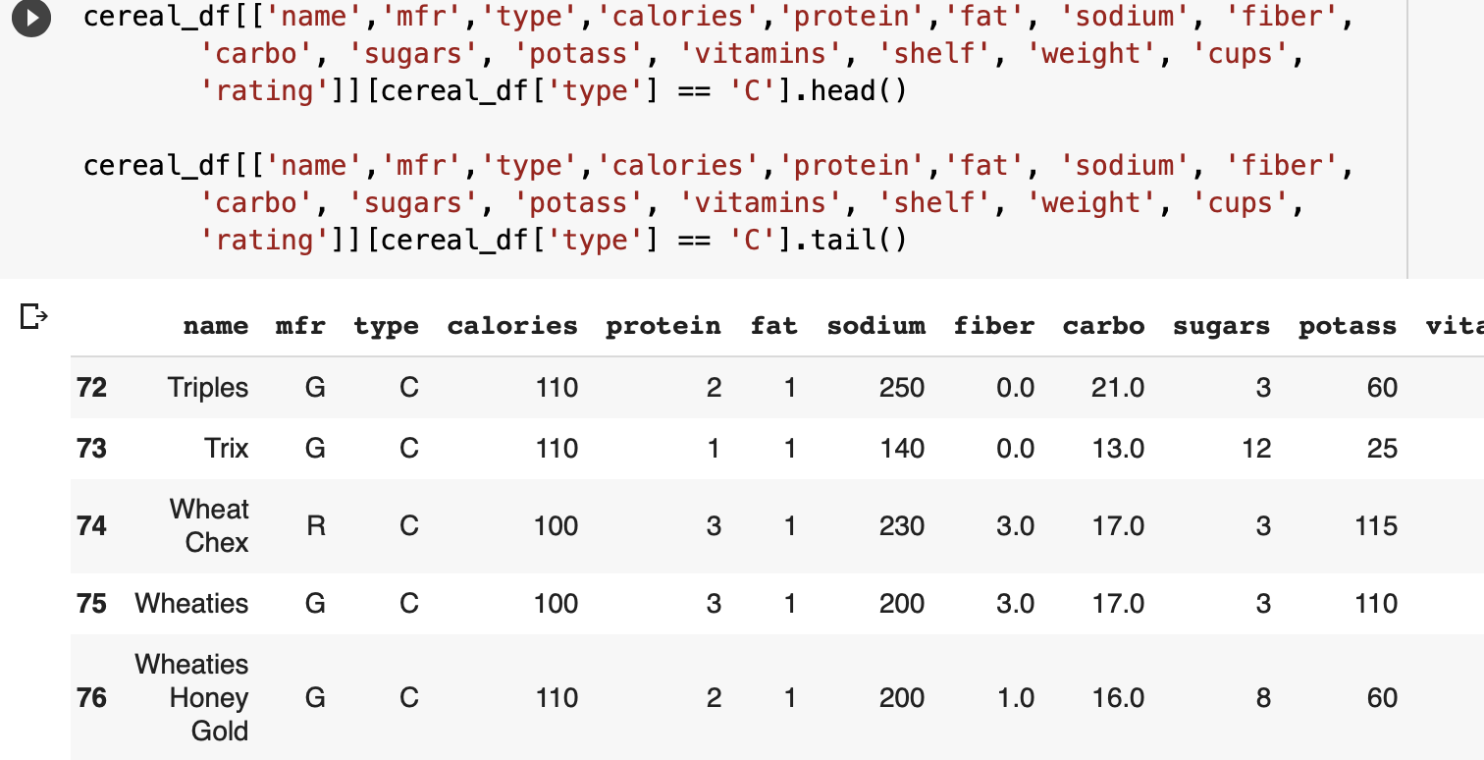
Summarizing Data 1 Categories: Type

Slide 8
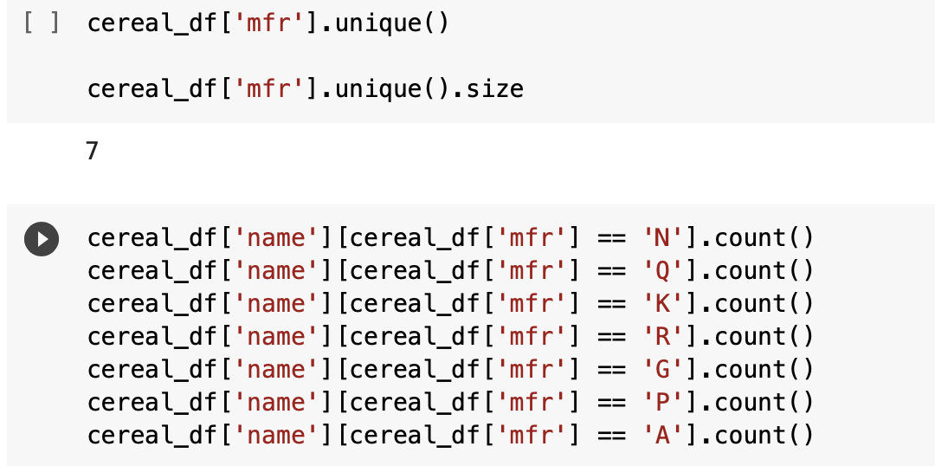
Categories: Manufacturer

Slide 9
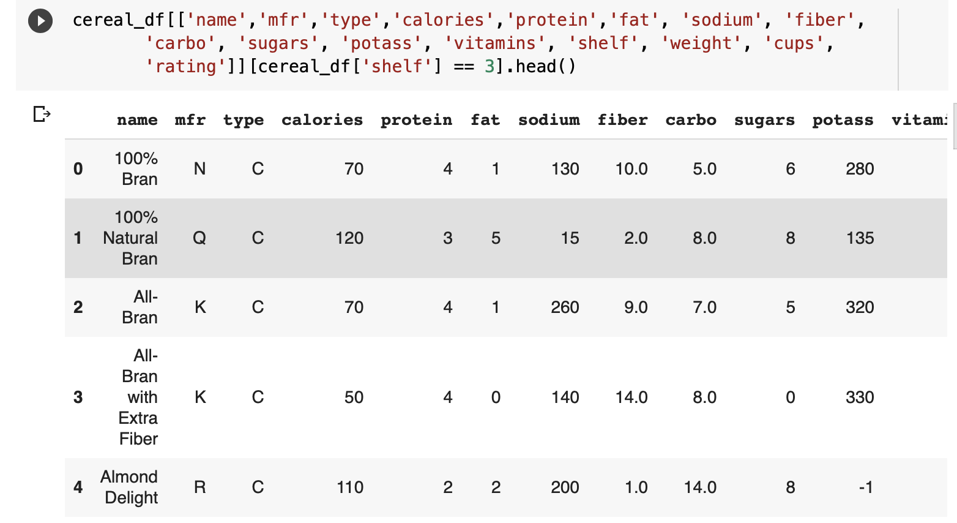
Categories: Shelf

Slide 10
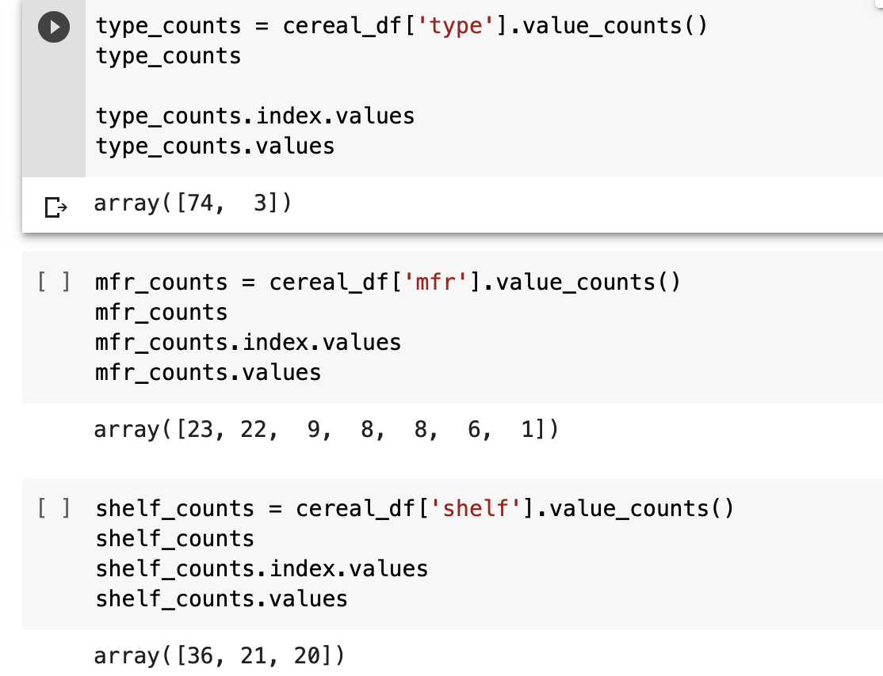
Visualizing data 1 By Single categorical variable

Slide 11
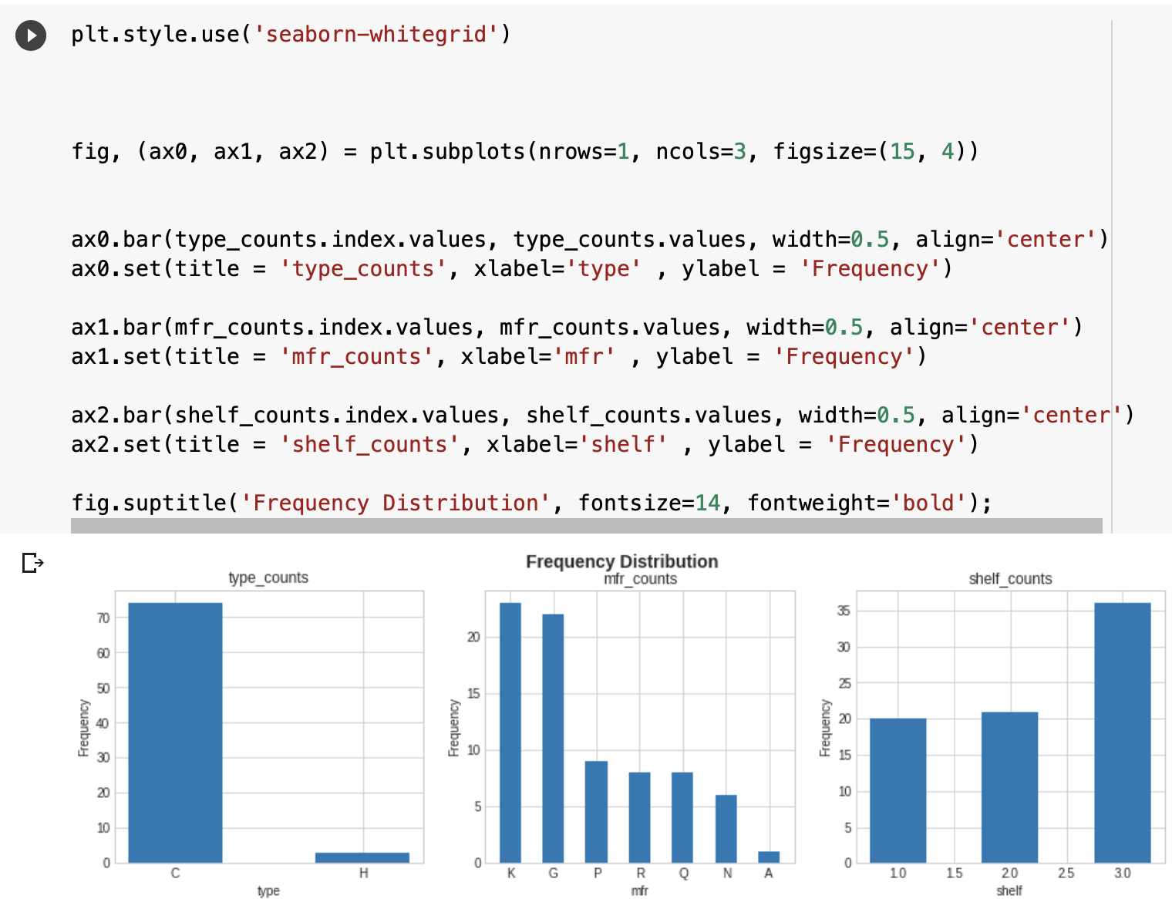
Bar plots for single categorical variable

Slide 12
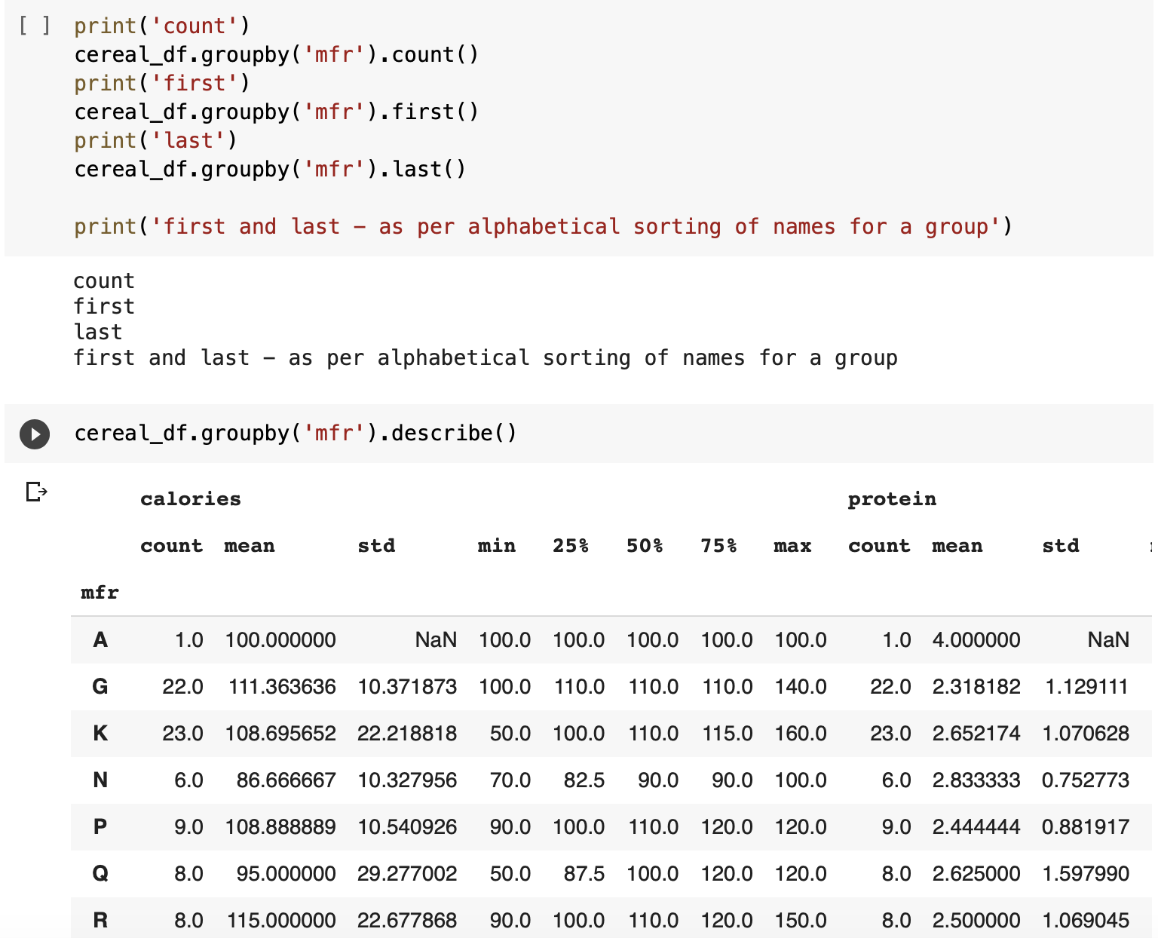
GroupBy commands

Slide 13
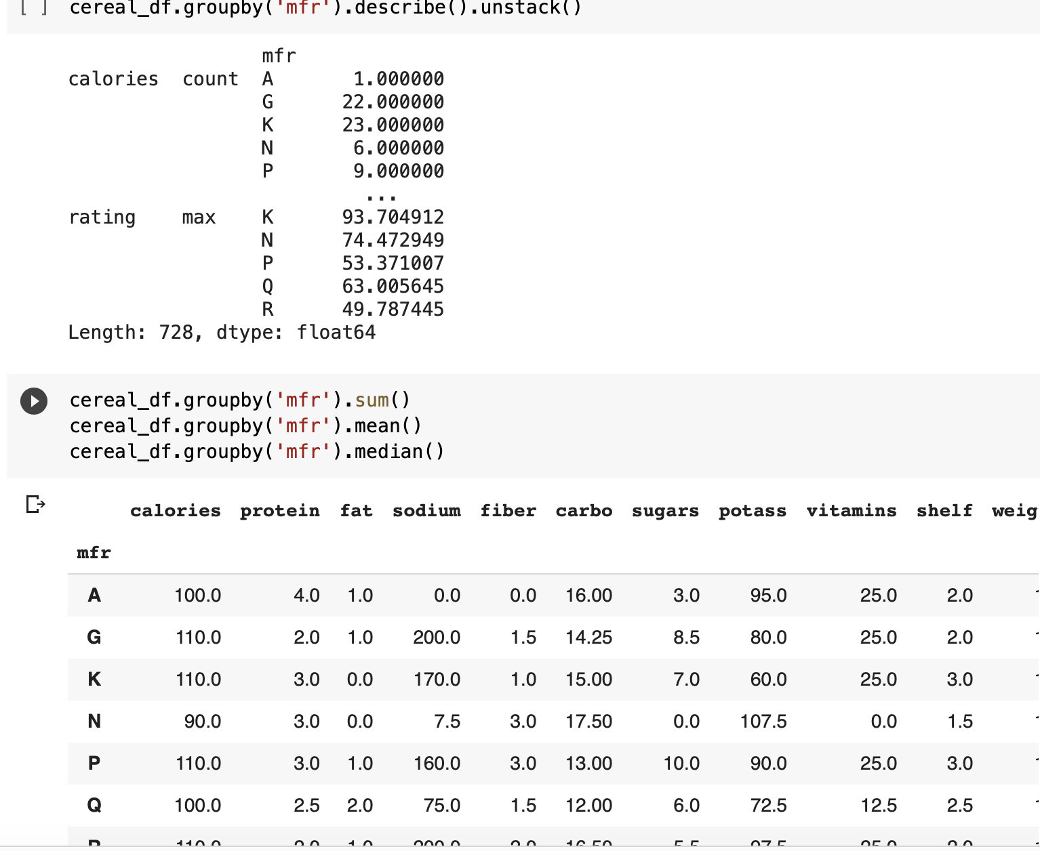
GroupBy commands

